Slide 1
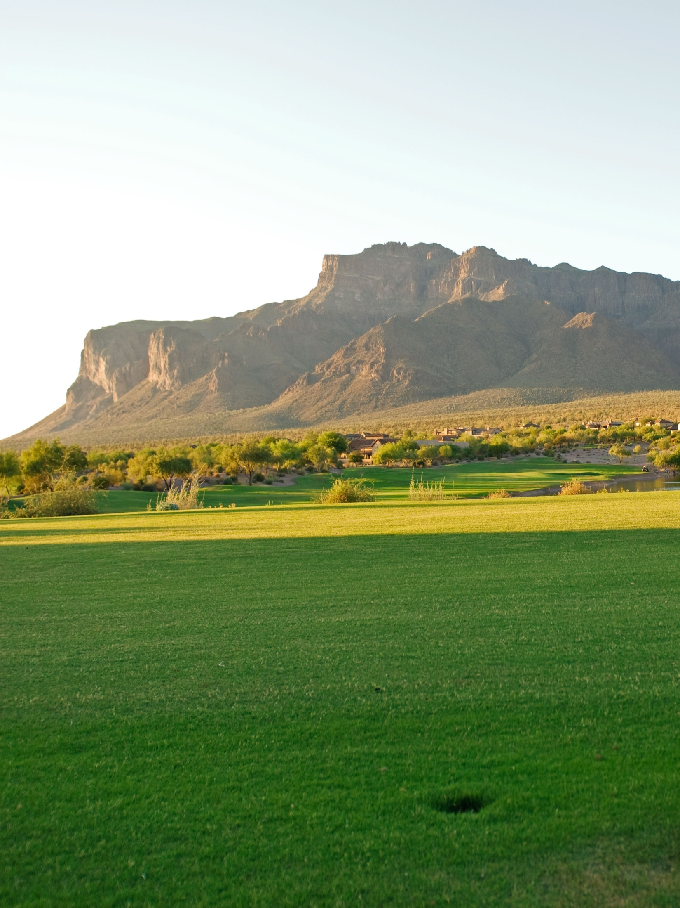
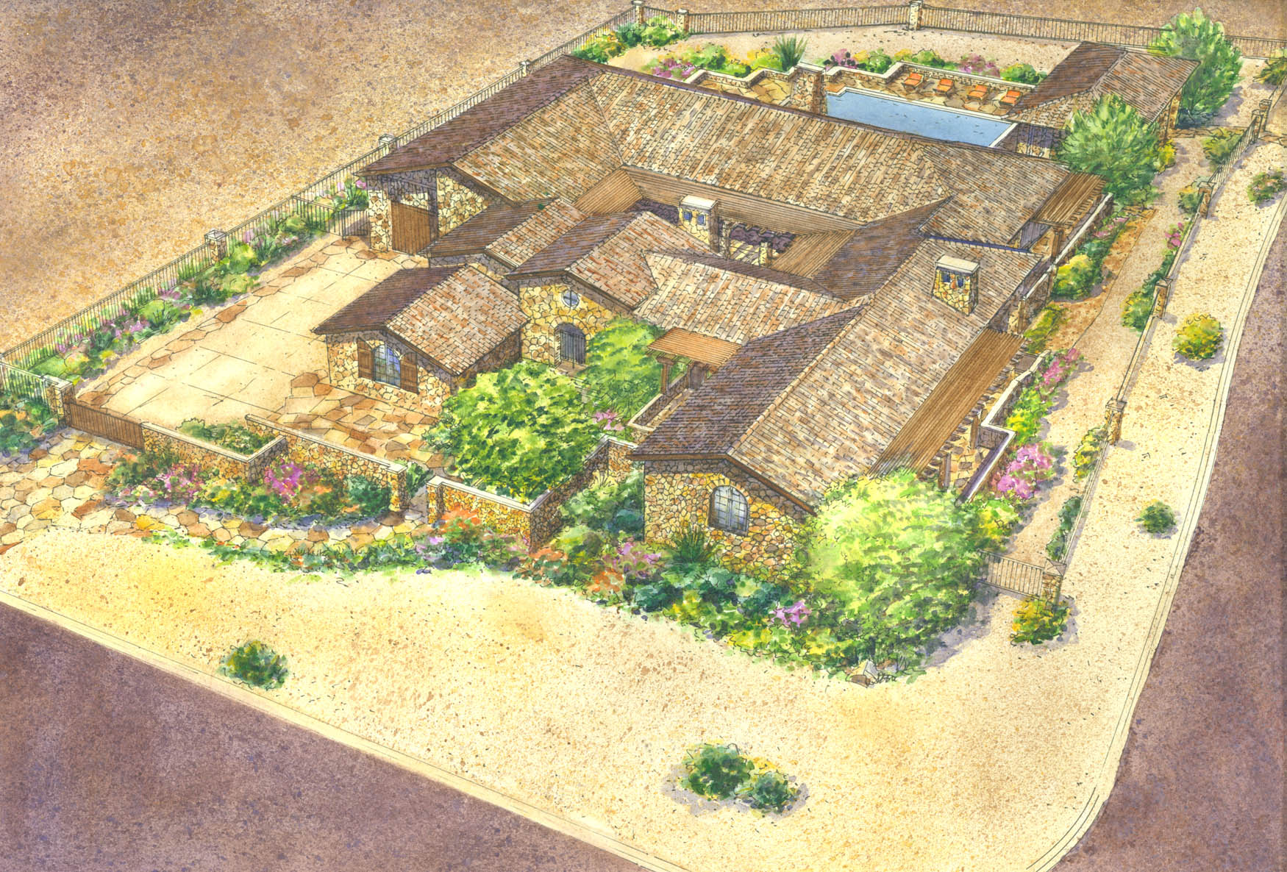
Lot 18 Ponderosa Village in Superstition Mountain
3605 S. Ponderosa Drive, Gold Canyon, Arizona
by CBC Luxury Builders
azroc #151962

Slide 2
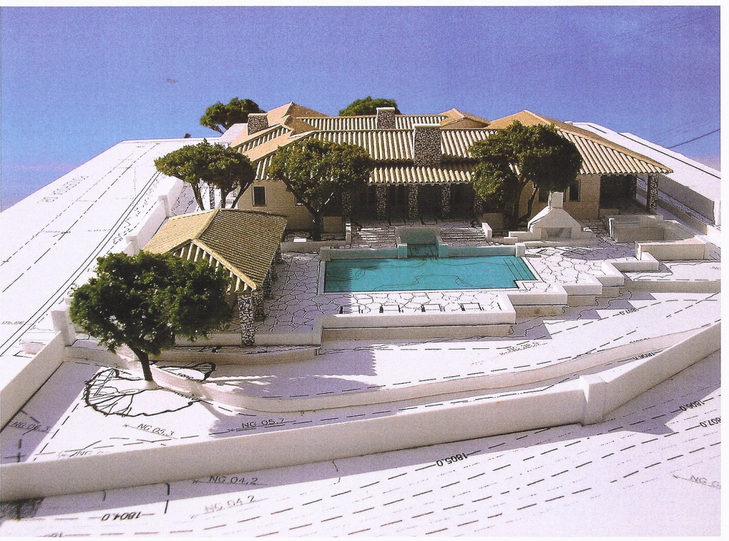
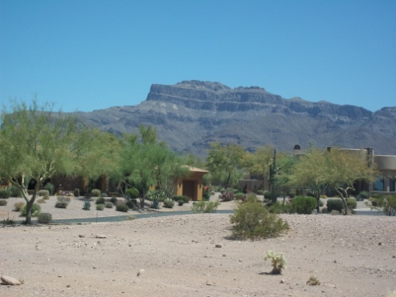
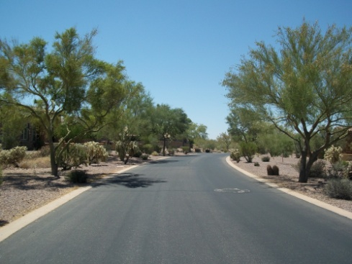
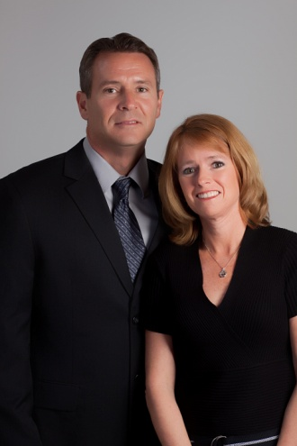

Priced at $1,889,000
Independence Realty Professionals, Inc.
4535 S. Lakeshore Drive, Ste #4, Tempe, AZ 85282
This Unique Luxury Home brought to you by :
Vince and Leslie Stark, Realtors
4255 S. Camino de Vida, Gold Canyon, AZ 85118
Office : 480-380-9400
Vince cell # 602-573-2170
Leslie cell # 602-573-2182
See attached amenities sheet for more details
or visit www.cbcarizonarealestate.com

